Slide 1
Principles
of
Security
Douglas Crockford

Slide 2
White hats vs. black hats.
Security is not hats.

Slide 3
Security is everyone’s job.
Don’t leave it to specialists.

Slide 4
Things Change

Slide 5
It is not unusual for the purpose or use or scope of software to change over its life. Rarely are the security properties of software systems reexamined in the context of new or evolving missions. This leads to insecure systems.

Slide 6
Don’t nobody do nothing stupid and nobody gets hurt.
And this means you.

Slide 7
Principles
Not trix and hax.

Slide 8
Deterrence is not effective.
You can’t punish an invisible attacker.

Slide 9
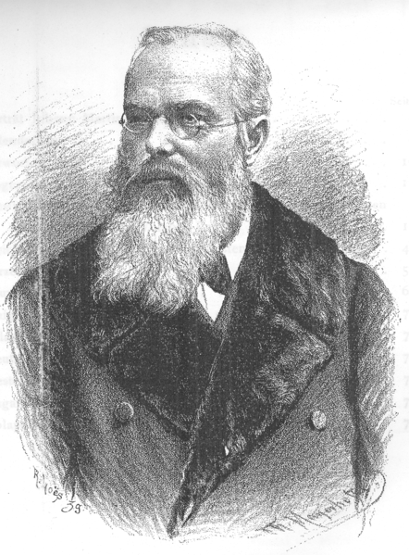
Johann Martin Schleyer

Slide 10
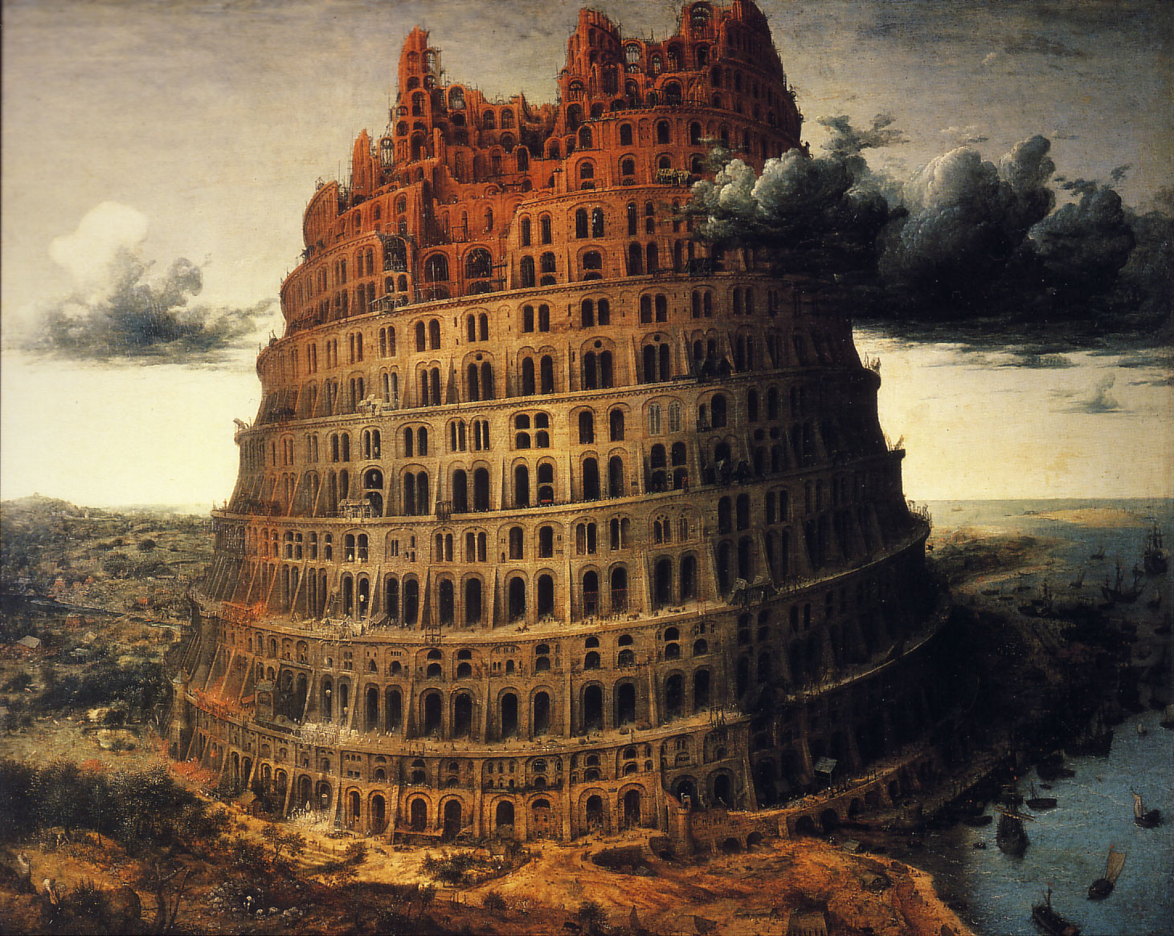

Slide 11
Volapük 1880
Debabelization

Slide 12
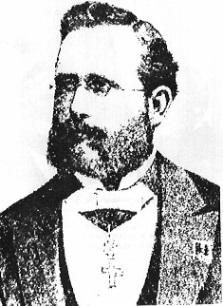
Jean Guillaume Auguste Victor François Hubert Kerckhoffs

Slide 13
Rebabelization
A secret vice.

Slide 14
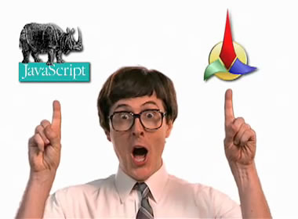

Slide 15
Auguste Kerckhoffs La Cryptographie Militaire 1883

Slide 16
The design of a system should not require secrecy; and compromise of the system should not inconvenience the correspondents.
The Kerckhoffs Principle

Slide 17
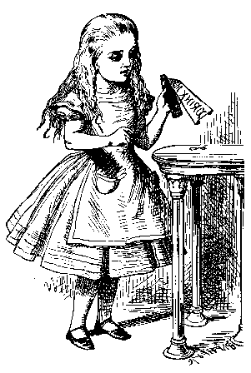

Alice
Bob

Slide 18
Key
Key
Plain text
Encrypt
Decrypt
Plain text
Cypher text
Cypher text

Slide 19
There is no security in obscurity.
The more secrets you have, the harder they are to keep.

Slide 20
One Time Pad
Truly unbreakable.

Slide 21
One Time Pad
The key must always remain secret.
The key must be at least as long as the plain text.
The cypher text is obtained by xor of the plain text and the key.

Slide 22

Plain text

Slide 23

Key

Slide 24

Cypher text

Slide 25
One Time Pad
The key must always remain secret.
The key must be at least as long as the plain text.
The cypher text is obtained by xor of the plain text and the key.
The key must be perfectly random.

Slide 26

Weak key

Slide 27

Weak cypher text

Slide 28
One Time Pad
The key must always remain secret.
The key must be at least as long as the plain text.
The cypher text is obtained by xor of the plain text and the key.
The key must be perfectly random.
A key must never be used more than once.

Slide 29

Plain text

Slide 30
Reuse key

Slide 31

Cypher text

Slide 32
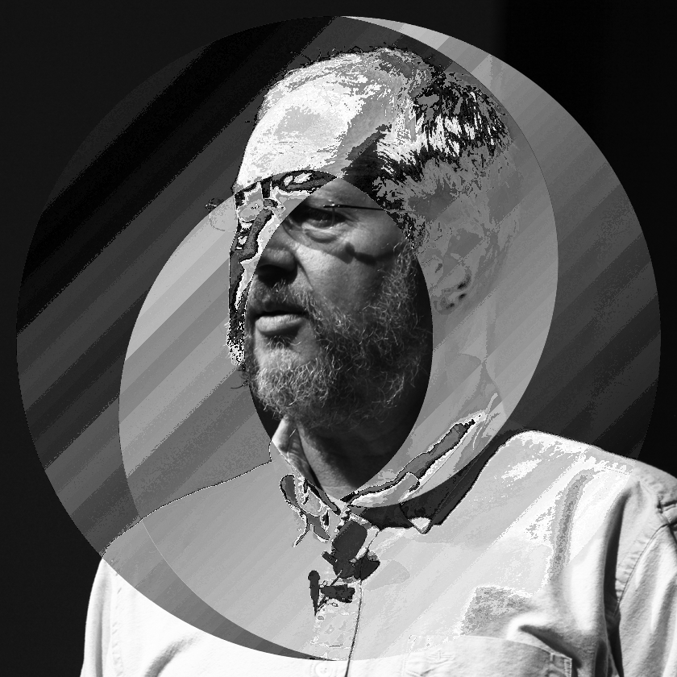
Cypher text xor cypher text

Slide 33
Cryptography is not security.

Slide 34
Alice
Bob

Slide 35
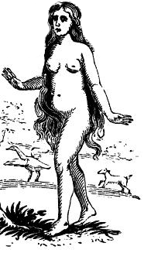
Alice
Eve
Bob

Slide 36
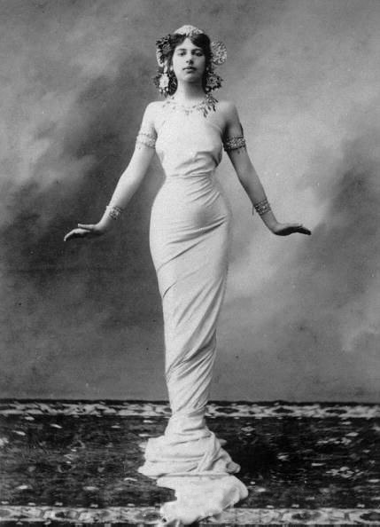
Alice
Mallory
Bob

Slide 37
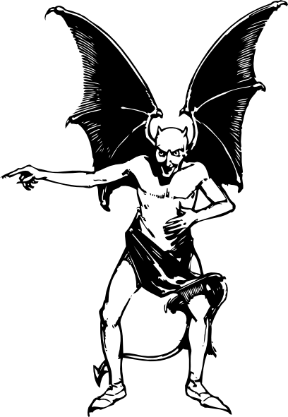
Alice
Satan

Slide 38
Security must be factored into every decision.

Slide 39
“We’ll go back and make it secure later.”

Slide 40
You can’t add security, just as you can’t add reliability.
Insecurity and unreliability must be removed.

Slide 41
Having survived to this point does not guarantee future survival.

Slide 42
The Impossible is not Possible.
If a measure is not effective, it is ineffective.

Slide 43
Don’t prohibit what you can’t prevent.
What you don’t prevent, you allow.

Slide 44
False security is worse than no security.
Unnecessary expense and confusion of risk.

Slide 45
The Web Browser Platform
Horribly insecure.
Still “fixing it later.”
HTML5 made it worse instead of better.
It is still better than everything else.

Slide 46
Blame the victim.

Slide 47
Who’s interest does the program represent?
The browser got this right. Every other platform for this wrong.

Slide 48
What the web got wrong
There can be more interests involved than the user’s and the site’s.
A malicious party can exploit coding conventions to inject malicious code.
That malicious code gets all of the rights of the site.
This is known as the XSS problem.

Slide 49
What can an attacker do if he gets some script into your page?

Slide 50
An attacker can request additional scripts from any server in the world.
Once it gets a foothold, it can obtain all of the scripts it needs.

Slide 51
An attacker can read the document.
The attacker can see everything the user sees.

Slide 52
An attacker can make requests of your server.
Your server cannot detect that the request did not originate with your application.

Slide 53
If your server accepts SQL queries, then the attacker gets access to your database.

Slide 54
An attacker has control over the display and can request information from the user.
The user cannot detect that the request did not originate with your application.

Slide 55
An attacker can send information to servers anywhere in the world.

Slide 56
The browser does not prevent any of these.
Web standards require these weaknesses.

Slide 57
The consequences of a successful attack are horrible.
Harm to customers.
Loss of trust.
Legal liabilities.

Slide 58
XSS
Cross Site Scripting

Slide 59
Cross site scripting attacks were invented in 1995.

Slide 60
Baby Steps
Content Security Policy W3C Editor's Draft 15 April 2013
<iframe sandbox> W3C Candidate Recommendation 17 December 2012
Unsafe by default.

Slide 61
A mashup is a self-inflicted XSS attack.
Advertising is a mashup.
The most reliable, cost effective method to inject evil code is to buy an ad.

Slide 62
Why is there XSS?
The web stack is too complicated.
Too many languages, each with its own encoding, quoting, commenting, and escapement conventions.
Each can be nested inside of each other.
Browsers do heroic things to make sense of malformed content.
Template-based web frameworks are optimized for XSS injection.

Slide 63
Why is there XSS?
The JavaScript global object gives every scrap of script the same set of powerful capabilities.
As bad as it is at security, the browser is a vast improvement over everything else.

Slide 64
Confusion of Interests
The browser distinguishes between the interests of the user and the interests of the site.
It did not anticipate that multiple interests might be represented.

Slide 65
Within a page, interests are confused.
An ad or a widget or an Ajax library gets the same rights as the site’s own scripts.

Slide 66
JavaScript got close to getting it right.
It can be repaired, becoming an object capability language.

Slide 67
HTML
HTML grants power to confusers.
HTML is easily confused.
HTML is forgiving because webmasters were/are incompetent.
HTML’s API, the DOM, is also insecure.

Slide 68
This stuff is not going to get fixed in a hurry.
It is up to the web developer to create secure applications on an insecure platform.
But there is hope…

Slide 69
Any unit of software should be given just the capabilities it needs to do its work, and no more.
The Principle of Least Authority

Slide 70
The Actor Model
1973

Slide 71
The Actor Model
An actor is a computational entity.
An actor can send a message to another actor only if it knows its address.
An actor can create a new actor.
An actor can receive messages.
Web workers are actors.
Web services are not…

Slide 72
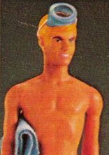
Waterken applies the actor model to web services.
Distributed, reliable services. http://www.waterken.com/

Slide 73
Capability
An address of an actor is a capability.
A reference to an object is a capability.

Slide 74
An Introduction to Object Capabilities

Slide 75
A is an Object.
Object A has state and behavior.

Slide 76
has-a
Object A has a reference to Object B.
An object can have references to other objects.

Slide 77
Object A can communicate with Object B...
...because it has a reference to Object B.

Slide 78
Object B provides an interface that constrains access to its own state and references.
Object A does not get access to Object B’s innards.

Slide 79
Object A does not have a reference to Object C, so Object A cannot communicate with Object C.
In an Object Capability System, an object can only communicate with objects that it has references to.

Slide 80
An Object Capability System is produced by constraining the ways that references are obtained.
A reference cannot be obtained simply by knowing the name of a global variable or a public class.

Slide 81
There are exactly three ways to obtain a reference.
By Creation.
By Construction.
By Introduction.

Slide 82
1. By Creation
If a function creates an object, it gets a reference to that object.

Slide 83
2. By Construction
An object may be endowed by its constructor with references.
This can include references in the constructor’s context and inherited references.

Slide 84
3. By Introduction
A has a references to B and C.
B has no references, so it cannot communicate with A or C.
C has no references, so it cannot communicate with A or B.

Slide 85
3. By Introduction
A calls B, passing a reference to C.

Slide 86
3. By Introduction
B is now able to communicate with C.
It has acquired the capability.

Slide 87
If references can only be obtained by Creation, Construction, or Introduction, then you may have a safe system.

Slide 88
Potential weaknesses include
Arrogation.
Corruption.
Confusion.
Collusion.

Slide 89
1. Arrogation
To take or claim for oneself without right.
Global variables.
public static variables.
Standard libraries that grant powerful capabilities like access to the file system or the network or the operating system to all programs.
Address generation.
Known urls.

Slide 90
2. Corruption
It should not be possible to tamper with or circumvent the system or other objects.

Slide 91
3. Confusion
It should be possible to create objects that are not subject to confusion. A confused object can be tricked into misusing its capabilities.

Slide 92
4. Collusion
It must not be possible for two objects to communicate until they are introduced.
If two independent objects can collude, they might be able to pool their capabilities to cause harm.

Slide 93
Rights Attenuation
Some capabilities are too dangerous to give to guest code.
We can instead give those capabilities to intermediate objects that will constrain the power.
For example, an intermediate object for a file system might limit access to a particular device or directory, or limit the size of files, or the number of files, or the longevity of files, or the types of files.

Slide 94
Ultimately, every object should be given exactly the capabilities it needs to do its work.
Capabilities should be granted on a need-to-do basis.
Information Hiding - Capability Hiding.

Slide 95
Intermediate objects, or facets, can be very light weight.
Class-free languages can be especially effective.

Slide 96
The Facet object limits the Guest object’s access to the Powerful object.
The Guest object cannot tamper with the Facet to get a direct reference to the Dangerous object.

Slide 97
References are not revocable.
Once you introduce an object, you can’t ask it to forget it.
You can ask, but you should not depend on your request being honored.

Slide 98
The Guest object has a reference to an Agency object. The Guest asks for an introduction to the Powerful object.

Slide 99
The Agency object makes a Facet, and gives it to the Guest.
The Facet might be a simple pass through.

Slide 100
When the Agency wants to revoke the capability, it tells the Facet to forget its capability.
The Facet is now useless to the Guest.

Slide 101
A Facet can mark requests so that the Powerful object can know where the request came from.

Slide 102
Facets
Very expressive.
Easy to construct.
Lightweight.
Attenuation: Power Reduction.
Revocation.
Notification.
Delegation.
The best OO patterns are also capability patterns

Slide 103
Attenuation is your friend
Facets can reduce the power of dangerous objects.
Most code should not be given direct access to innerHTML or document.write.
Instead of trying to guess if a piece of code can do something bad, give it safe capabilities instead.
Capabilities can aid in API design.

Slide 104
Function the Ultimate
Corrupting a single object results in a corrupted object, not a corrupted system.

Slide 105
The Lazy Programmer’s Guide to Secure Computing Marc Stiegler
http://www.youtube.com/watch? v=eL5o4PFuxTY

Slide 106
var table = (function () {
var array = [];
return {
get: function (i) {return array[i]; },
store: function (i, v) {array[i] = v; },
append: function (v) {array.push(v); }
};
}());

Slide 107
var table = (function () {
var array = [];
return {
get: function (i) {return array[i]; },
store: function (i, v) {array[i] = v; },
append: function (v) {array.push(v); }
};
}());
var score;
table.store('push', function () {
score = this;
});
table.append(); // score === array

Slide 108
Confusion

Slide 109
Confusion aids the enemy.
Bugs are a manifestation of confusion.

Slide 110
With great complexity comes great confusion.
Keep it simple. Keep it clean.

Slide 111
Code Well
Good code is ultimately cheaper to produce than bad code, so might as well always write good code.
Good code is easier to reason about.
Code that is difficult to reason about is more likely to be problematic.
Strict conformance to good style rules.
http://www.JSLint.com/

Slide 112
Never trust a machine that is not under your absolute control.
Don’t get more intimate that sharing JSON payloads.

Slide 113
Never trust the browser
It cannot and will not protect your interests.
Properly filter and validate all input.
Properly encode all output.
Context is everything.
Filter and encode for the correct context.

Slide 114
Templating and Temporary Insanity

Slide 115
The browser is a loaded gun pointed at your head. This pulls the trigger: <?= "bang" ?>

Slide 116
A Simple Attack
http://yoursite.com/<script>...</script>
<html><body>
<p>404 File not found: <script>...</script>
</p></body></html>
The script runs with the authority of your site.
The script gets cookies, local storage, everything.

Slide 117
Confusion and Concatenation
Properly encode all of the non-literal pieces.

Slide 118
“Why would anyone do that?”

Slide 119
Inconvenience is not security. Identity is not security. Taint ain’t security. Intrusion detection is not security.

Slide 120
Mismanagement

Slide 121
Danog ols e neit gudik.

Slide 122
Danog ols e neit gudik.
Thank you and good night.

Slide 123
Security is everyone’s job.
Don’t nobody do nothing stupid and nobody gets hurt.
Deterrence is not effective.
The design of a system should not require secrecy; and compromise of the system should not inconvenience the correspondents.
There is no security in obscurity.
Cryptography is not security.
Security must be factored into every decision.
You can’t add security, just as you can’t add reliability.
The Impossible is not Possible.
False security is worse than no security.
Any unit of software should be given just the capabilities it needs to do its work, and no more.
Confusion aids the enemy.
Never trust a machine that is not under your absolute control.
Inconvenience is not security.
Identity is not security.
Taint ain’t security.
Intrusion detection is not security.
Security is everyone’s job.

